Slide 1

Earth System Model Evaluation Tool (ESMValTool)
Veronika Eyring^{1,2}, Axel Lauer¹, Mattia Righi¹, Björn Brötz¹, Niels Drost³, Nikolay Koldunov⁴, Ben Müller⁵, Valeriu Predoi⁶, Javier Vegas-Regidor⁷
ESMValTool PI and Core Developers
¹Deutsches Zentrum für Luft- und Raumfahrt e.V. (DLR), Institute of Atmospheric Physics, Oberpfaffenhofen, Germany
²University of Bremen, Institute of Environmental Physics, Bremen, Germany
³Netherlands e-Science Center (NLeSC), Netherlands
⁴Alfred-Wegener-Institute Bremerhaven (AWI), Germany
⁵Ludwig Maximilian University of Munich, Germany
⁶University of Reading, UK
⁷Barcelona Computing Center (BSC), Spain
16 February 2018

Slide 2
Outline
Motivation
Brief Overview ESMValTool and Development Team
Examples for ESMValTool diagnostics, performance metrics, namelists and observations included
ESMValTool Result Browser for CMIP at DKRZ
ESMValTool Quicklook and Monitoring Capability
Technical Improvements

Slide 3
1. Motivation

Slide 4

CMIP6: Participating Model Groups
 | Institution | Country |  | Institution | Country |  | Institution | Country
1 | AWI | Germany | 12 | DOE | USA | 23 | MRI | Japan
2 | BCC | China | 13 | EC-Earth-Cons | Europe | 24 | NASA-GISS | USA
3 | BNU | China | 14 | FGOALS | China | 25 | NCAR | USA
4 | CAMS | China | 15 | FIO-RONM | China | 26 | NCC | Norway
5 | CasESM | China | 16 | INM | Russia | 27 | NERC | UK
6 | CCCma | Canada | 17 | INPE | Brazil | 28 | NIMS-KMA | Republic of Korea
7 | CCCR-IITM | India | 18 | IPSL | France | 29 | NOAA-GFDL | USA
8 | CMCC | Italy | 19 | MESSY-Cons | Germany | 30 | NUIST | China
9 | CNRM | France | 20 | MIROC | Japan | 31 | TaiESM | Taiwan, China
10 | CSIR-CSIRO | South Africa | 21 | MOHC | UK | 32 | THU | China
11 | CSIRO-BOM | Australia | 22 | MPI-M | Germany | 33 | Seoul Nat.Uni | Republic of Korea
New in CMIP:
2 new model groups from Germany (AWI, MESSY-Consortium)
4 new model groups from China (CAMS, CasESM, NUIST, THU)
1 new model group from Brazil (INPE)
1 new model group from India (CCCR-IITM)
1 new model group from Taiwan, China (TaiESM)
1 new model group from USA (DOE)
2 new model group from Republic of Korea (NIMS-KMA, SAM0-UNICON)
1 new model group from South Africa / Australia (CSIR-CSIRO)
========================================
13 new model groups so far
* Other models can join providing DECK and historical simulations are submitted
More models (>70)
New models
More complex models
Higher resolution models

Slide 5
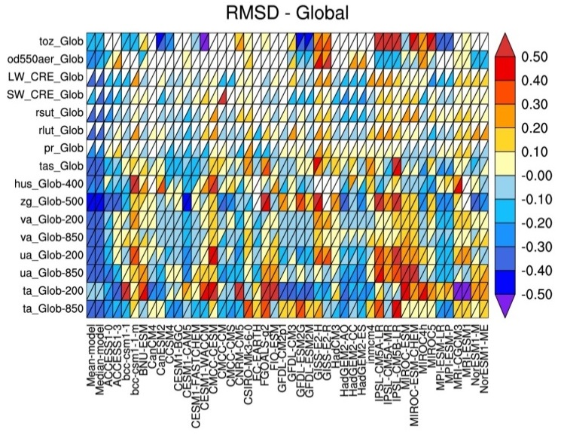
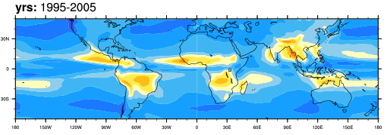
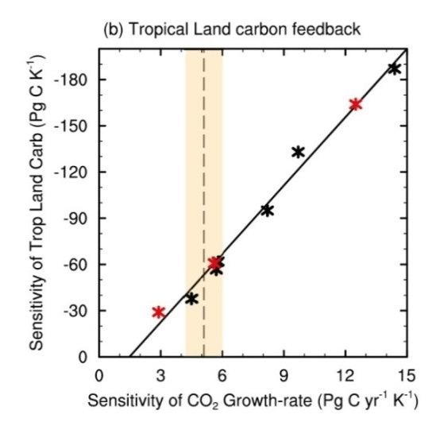
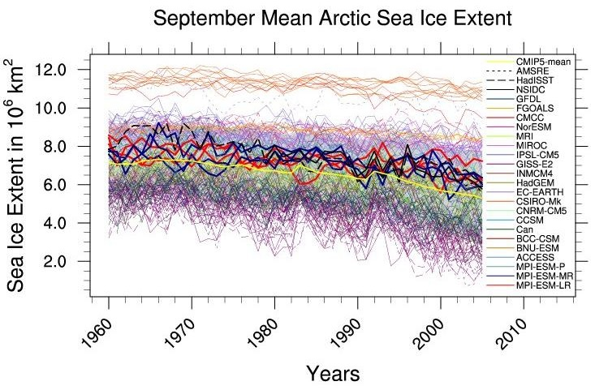
How to characterize the wide variety of models in CMIP6?
- Routine Benchmarking and Evaluation Central Part of CMIP6 -
The Earth System Model Evaluation Tool (ESMValTool, Eyring et al., ESMValTool, GMD (2016b)) includes other software packages such as the NCAR CVDP (Phillips et al., 2014)), to produce well-established analyses as soon as CMIP model output is submitted.
Similar to Figure 9.7 of AR5
Broad Characterization of Model Behavior
(incl. IPCC AR5 Chap 9 & 12 diagnostics in ESMValTool)
CMIP5 MMM
Monsoon Precipitation Intensity
CMIP5 MMM - OBS
Running alongside the ESGF
Similar to Figure 9.5 of AR5
Link to projections
Similar to Figure 9.24 of AR5
Net Cloud radiative effect against CERES EBAF
Similar to Figure 9.24 of AR5

Slide 6
2. Brief Overview ESMValTool and Development Team

Slide 7

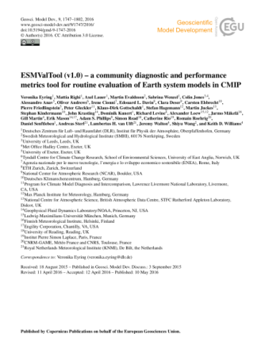

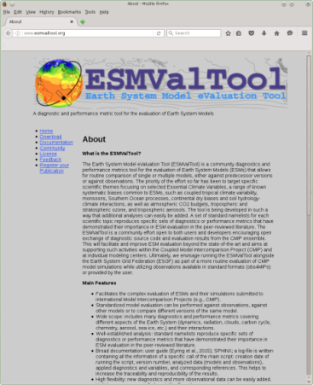


ESMValTool version 1.1.0 released as open source software
Community diagnostics and performance metrics tool for the evaluation of Earth System
Standardized model evaluation can be performed against observations, against other models or to compare different versions of the same model
Many diagnostics and performance metrics covering different aspects of the Earth System (dynamics, radiation, clouds, carbon cycle, chemistry, aerosol, sea-ice, etc.) and their interactions
Well-established analysis based on peer-reviewed literature
Ensuring traceability and provenance (e.g. input data, metadata, diagnostics (incl .citation), tool version, doi)
Documentation and user guide
Currently ≈ 80 scientist from >30 institutions part of the development team and > 120 users
Development in several projects (e.g. APPLICATE, CMIP6-DICAD, CRESCENDO, C3S-MAGIC, ESA CMUG, PRIMAVERA)
Rapidly expanding
http://www.esmvaltool.org/
Eyring et al., GMD, ESMValTool v1.0, 2016
https://github.com/ESMValGroup/ESMValTool
Eyring et al., ESMValTool v1.0, GMD, 2016
v2.0 documentation paper for CMIP6 in prep.

Slide 8
Examples of Projects with ESMValTool Development and Application
Name | Funder | Duration | Scientific Focus | Technical Focus | Partners
APPLICATE | EU Horizon 2020 | 11/16-10/20 | Arctic, user-relevant impact metrics, linkages in atmosphere & ocean, sea ice | --- | AWI and other APPLICATE partners
C3S-MAGIC C3S-511 | Copernicus Climate Change Serv. | 10/16-03/19 | Metrics incl. extreme events, coastal, water, energy and insurance Quality Control Observations | Quasi-operational on new C3S-Server, rewrite of backend with IRIS | NLeSC, KNMI, DLR, URead, BSC, ISAC-CNR, SMHI
CMIP6-DICAD | BMBF | 07/16-06/20 | Routine Benchmarking | Coupling to ESGF at DKRZ; visualization | DLR, DKRZ, FUB
CRESCENDO | EU Horizon 2020 | 11/15-10/20 | IPCC Ch. 9&12, ESM diagnostics & metrics (terrestrial, marine, chemistry, aerosols) | Coupling to ESGF at BADC; reporting and testing | DLR, ETH, LMU, UREAD, ENEA, SMHI, UNEXE
DLR Projects | DLR | 2010-ongoing | Emergent constraints, aerosols, chemistry, clouds, sea ice | ESMValTool coord., efficiency, provenance | DLR
EMBRACE | EU FP7 | 11/11-02/16 | ESM diagnostics and metrics | Get it running on all CMIP5 models, Documentation | DLR, SMHI, KNMI, MPI-M, FMI, ETH, UEA, UNEXE, METUK, CNRS-IPSL, CNRS-MF
ESA CCI CMUG | ESA | 07/14-06/17 | ESA CCI data and diagnostics | Reporting | DLR, LMU, SMHI, MetOffice
PRIMAVERA | EU Horizon 2020 | 11/15-10/19 | Assess added level of high res.; processes (e.g., AMO, Gulf stream, interactions of ice & polar storms, northward ocean heat transport | Improving the backend‘s efficiency | BSC and other PRIMAVERA partners

Slide 9
Current Status: Contributing Institutions (currently ~80 scientist from >30 institutions part of the development team )
Deutsches Zentrum für Luft- und Raumfahrt (DLR), Institut für Physik der Atmosphäre, Germany PI
Alfred-Wegener-Institute Bremerhaven (AWI), Germany Core Developer APPLICATE
Barcelona Computing Center (BSC), Spain, Core Developer PRIMAVERA / Copernicus MAGIC
Ludwig Maximilian University of Munich, Germany, Core Developer CRESCENDO
Netherlands e-Science Center (NLeSC), Core Developer Copernicus MAGIC technical developments
University of Reading, UK, Core Developer Copernicus MAGIC / CRESCENDO technical developments
Colorado State University, USA
Deutsches Klimarechenzentrum (DKRZ), Germany
Agenzia nazionale per le nuove tecnologie, l’energia e lo sviluppo economico sostenibile (ENEA), Italy
ETH Zurich, Switzerland
Finnish Meteorological Institute (FMI), Finland
GERICS Climate Service Center, Hamburg, Germany
Geophysical Fluid Dynamics Laboratory (GFLD) NOAA, USA
Instituto Nacional de Pesquisas Espaciais (INPE), Brazil
Institute of Atmospheric Sciences and Climate – Consiglio Nazionale delle Ricerche (ISAC-CNR), Italy
IPSL, France
Max-Planck-Institute (MPI) for Meteorology, Hamburg, Germany
MPI for Biogeochemistry, Jena, Germany
Met Office Hadley Centre, UK
Meteo France, France
MetNorway, Norway
New Mexico Tech, USA
Nansen Environmental and Remote Sensing Center, Norway
National Center for Atmospheric Research (NCAR), USA
KNMI, The Netherlands
Several institutes working on technical improvements and backend
SMHI, Norrköping, Sweden
Tyndall Centre, UK
University of Arizona, USA
University of East Anglia (UEA), UK
University of Exeter, Exeter, UK
University of Hamburg, Germany
University of Leeds, UK
Wageningen University, The Netherlands

Slide 10
3. Examples for ESMValTool diagnostics, performance metrics, namelists and observations included

Slide 11
Diagnostics and metrics included
Aerosol
Blocking diagnostics
Catchment analysis, runoff, ET
Clouds
Cloud regime error metric (CREM)
CO₂ and CH₄
Diurnal cycle of convection
Emergent constraints
Evapotranspiration
Indices for extreme events (Climdex)
IPCC AR5 chapter 9 and 12
Land and ocean components of the global carbon cycle
Land-atmosphere coupling
Land cover
Marine biogeochemistry
Madden-Julian Oscillation (MJO)
NCAR climate variability diagnostics package (CVDP)
Ozone, precursors and climate impacts
Performance metrics
Shifts in Austral jets
Snowfall
Soil moisture
Sea surface temperature
South Asian monsoon
Sea ice
Soil moisture
Southern Hemisphere
Southern Ocean (SOCCOM work in progress)
Standardized precipitation index (SPI)
Tropical variability
Tropospheric Ozone
West African monsoon
Land cover
Precipitation – soil moisture

Slide 12
Examples of ESMValTool Namelist
namelist_CVDP.xml
namelist_DiurnalCycle_xxx.xml
namelist_Emmons.xml
namelist_EmergentConstraints.xml
namelist_Evapotranspiration.xml
namelist_GlobalOcean.xml
namelist_SAMonsoon.xml
namelist_SPI.xml
namelist_SeaIce.xml
namelist_SouthernHemisphere.xml
namelist_SouthernOcean.xml
namelist_TropicalVariability.xml ESMV
namelist_WAMonsoon.xml
namelist_aerosol_CMIP5.xml
namelist_anav13jclim.xml
namelist_clouds_bias.xml
namelist_eyring13jgr.xml
namelist_flato13ipcc.xml (IPCC AR5 Ch 9)
namelist_lauer13jclim.xml
namelist_lauer17rse.xml
namelist_mjo_mean_state.xml
namelist_mmm.xml
namelist_perfmetrics_CMIP5.xml
namelist_reformat.xml
namelist_reformat_obs.xml
namelist_righi15gmd_ECVs.xml
namelist_righi15gmd_Emmons.xml
namelist_righi15gmd_tropo3_CMIP5.xml
namelist_runoff_et.xml
namelist_sm_pr.xml
namelist_wenzel14jgr.xml
namelist_williams09climdyn_CREM.xml
namelist_ecs.xml
namelist_collins13ipcc.xml (AR5 Ch 12)

Slide 13

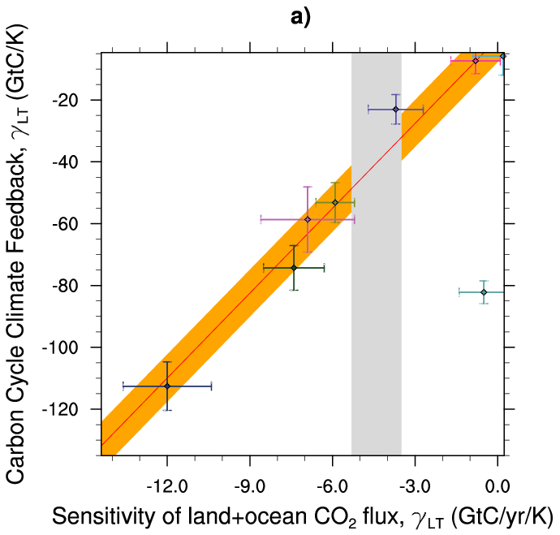
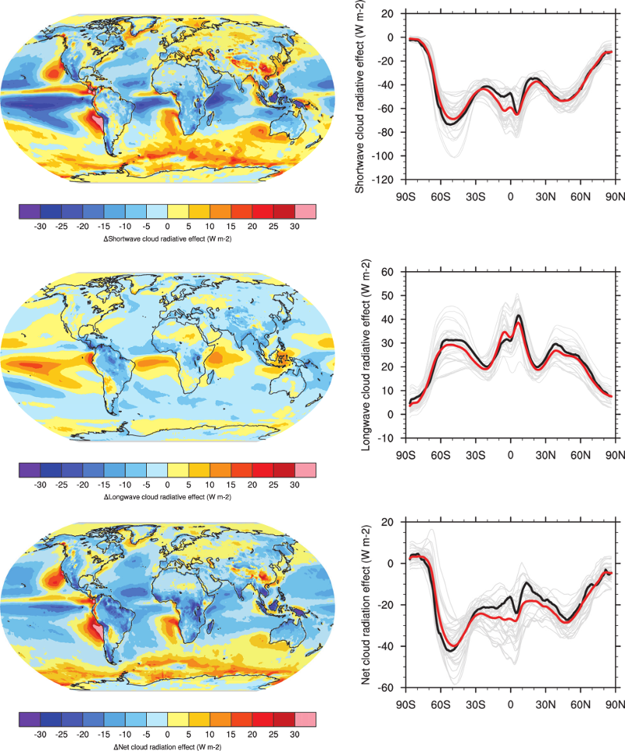
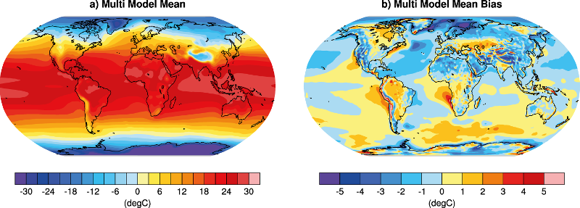
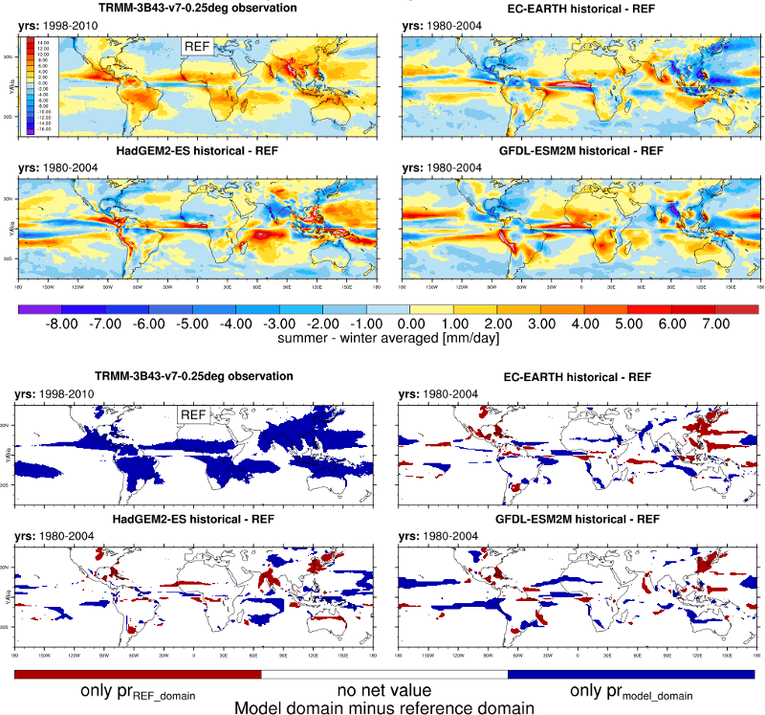
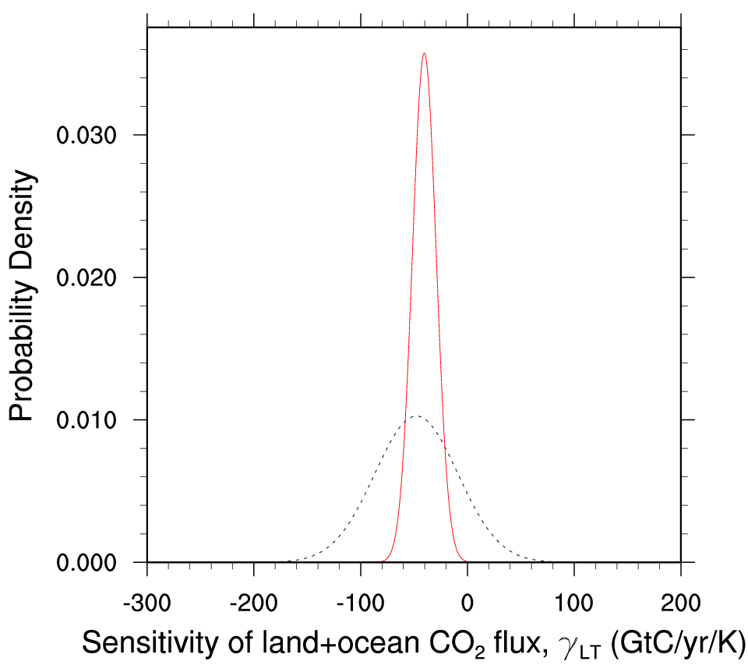
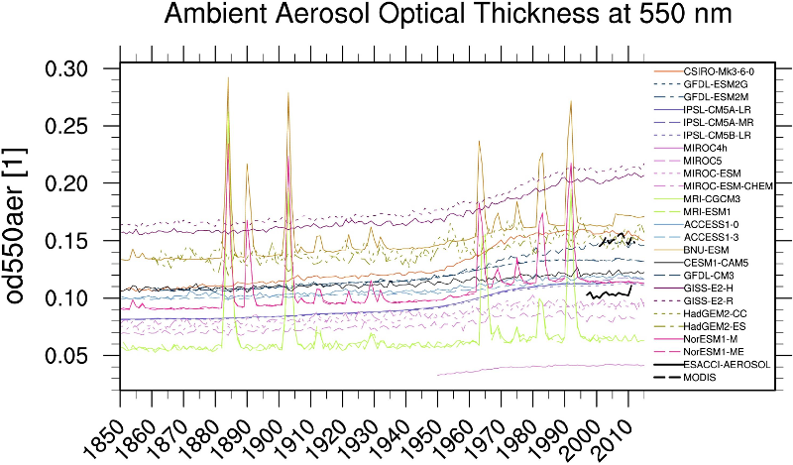
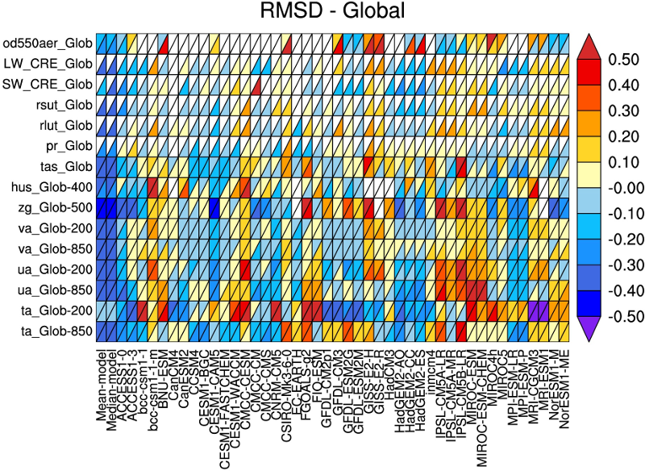
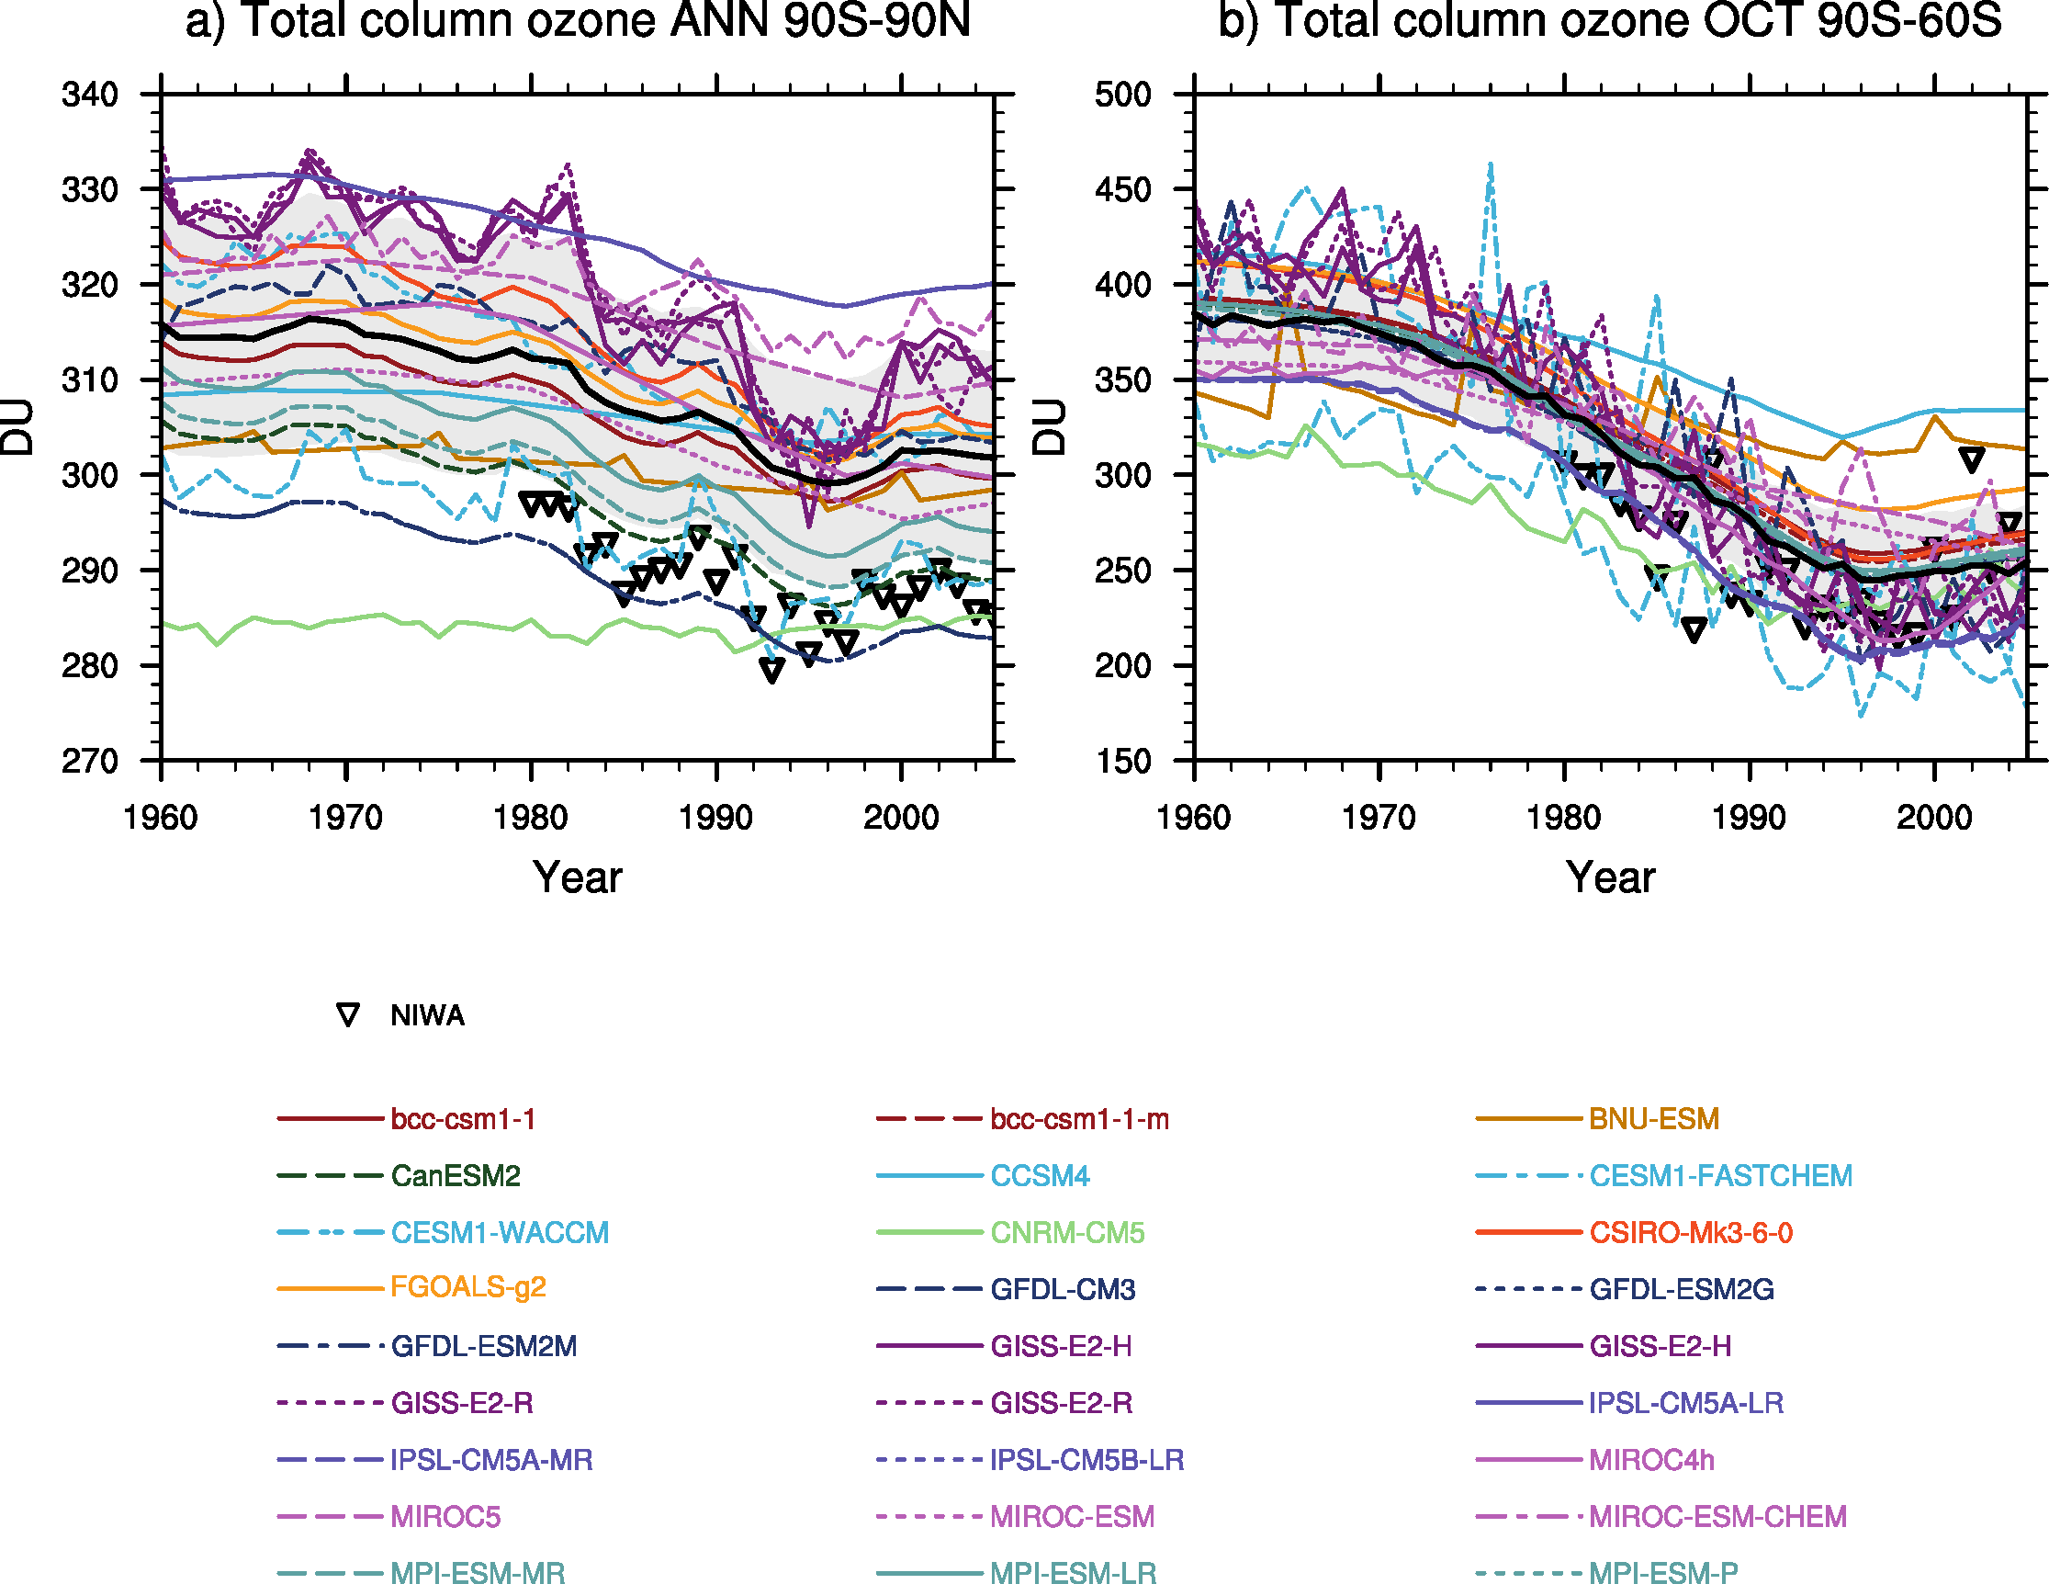
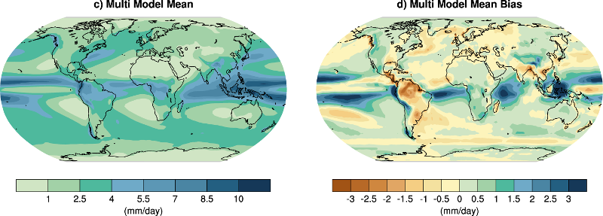
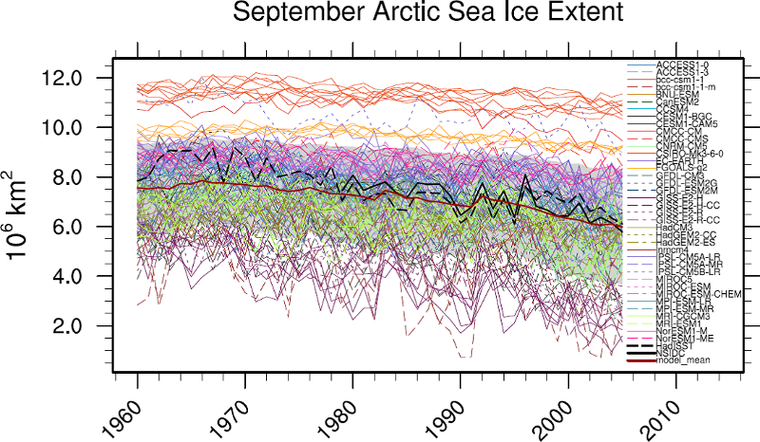

Diagnostics – IPCC AR5 chapter 9

Slide 14
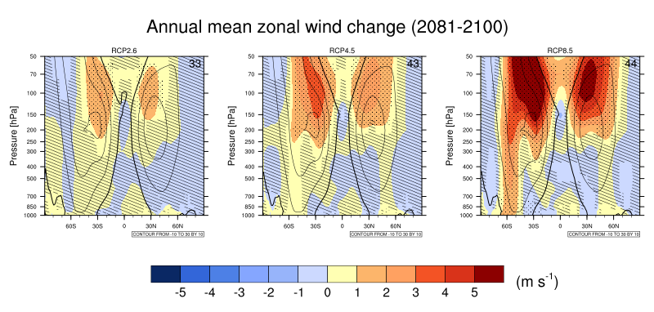
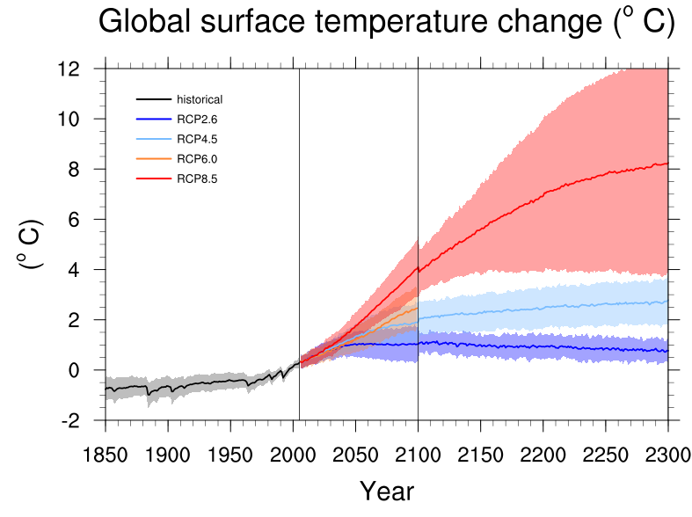
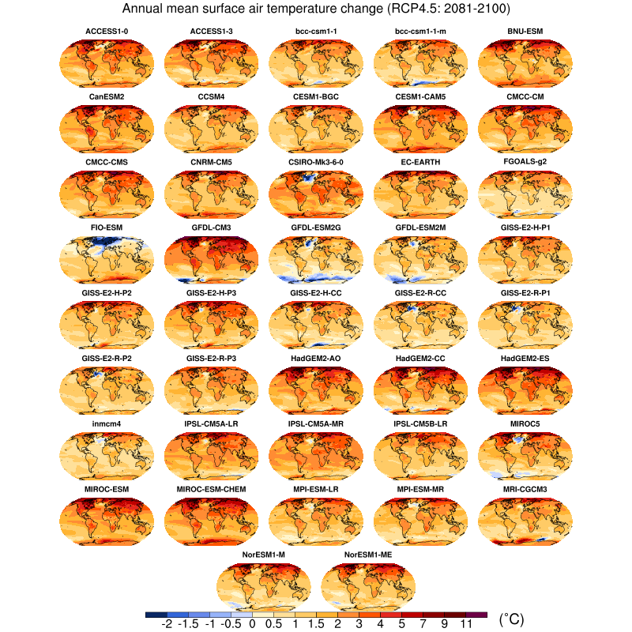
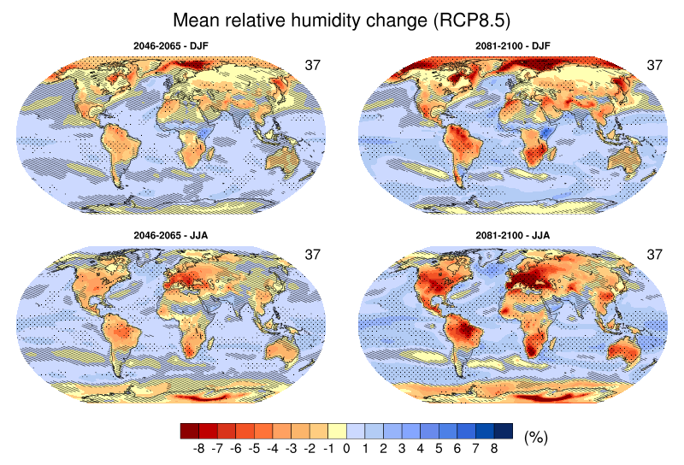
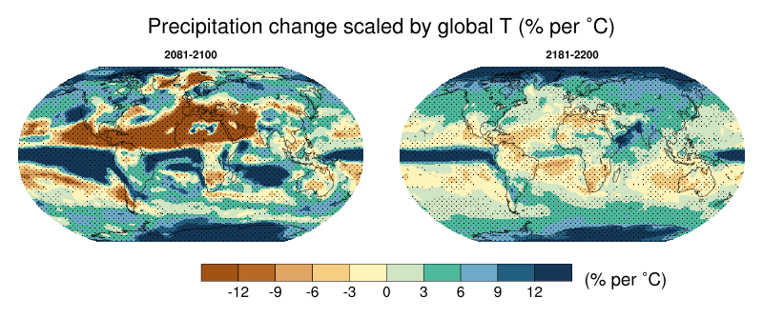
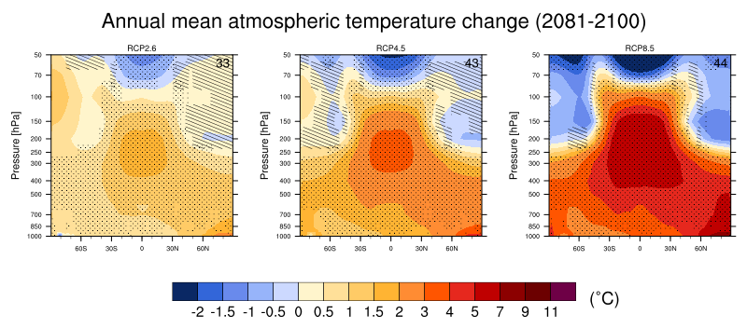
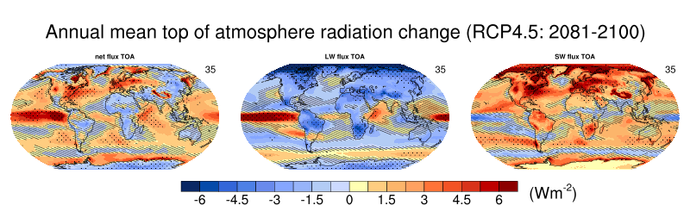
Diagnostics – IPCC AR5 chapter 12

Slide 15
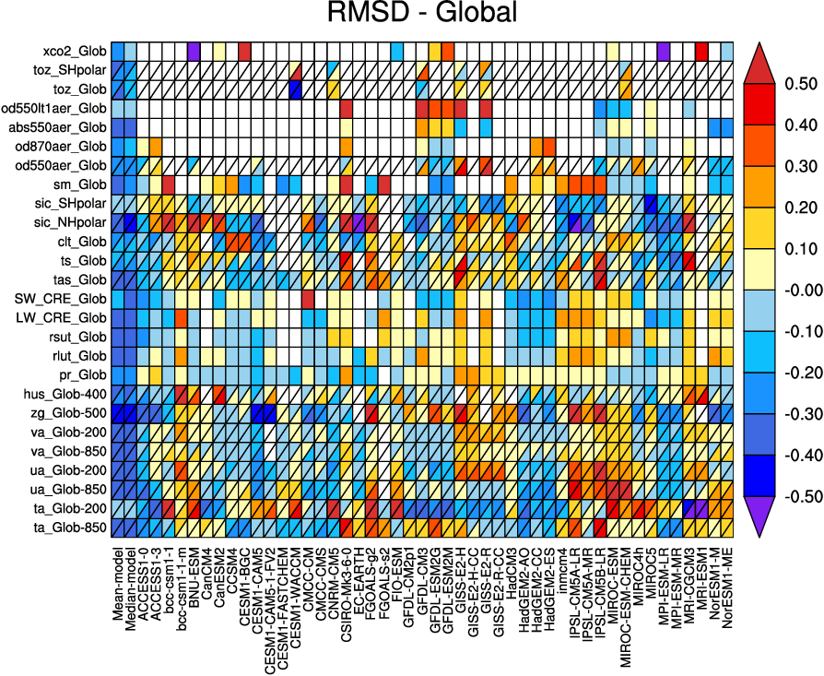
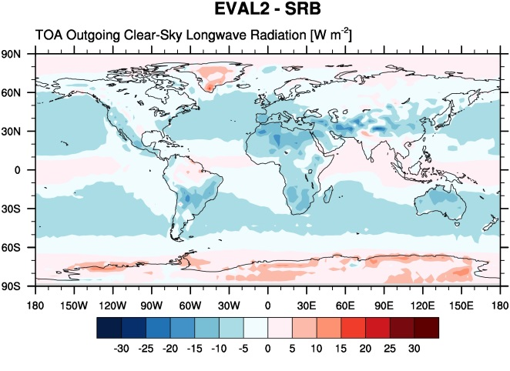
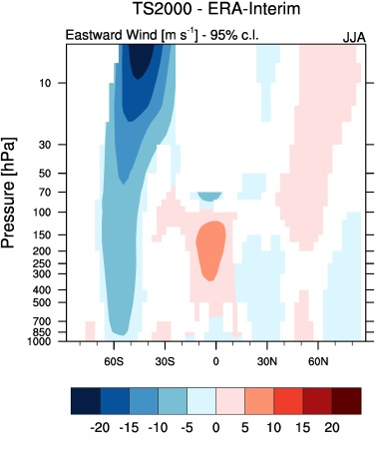
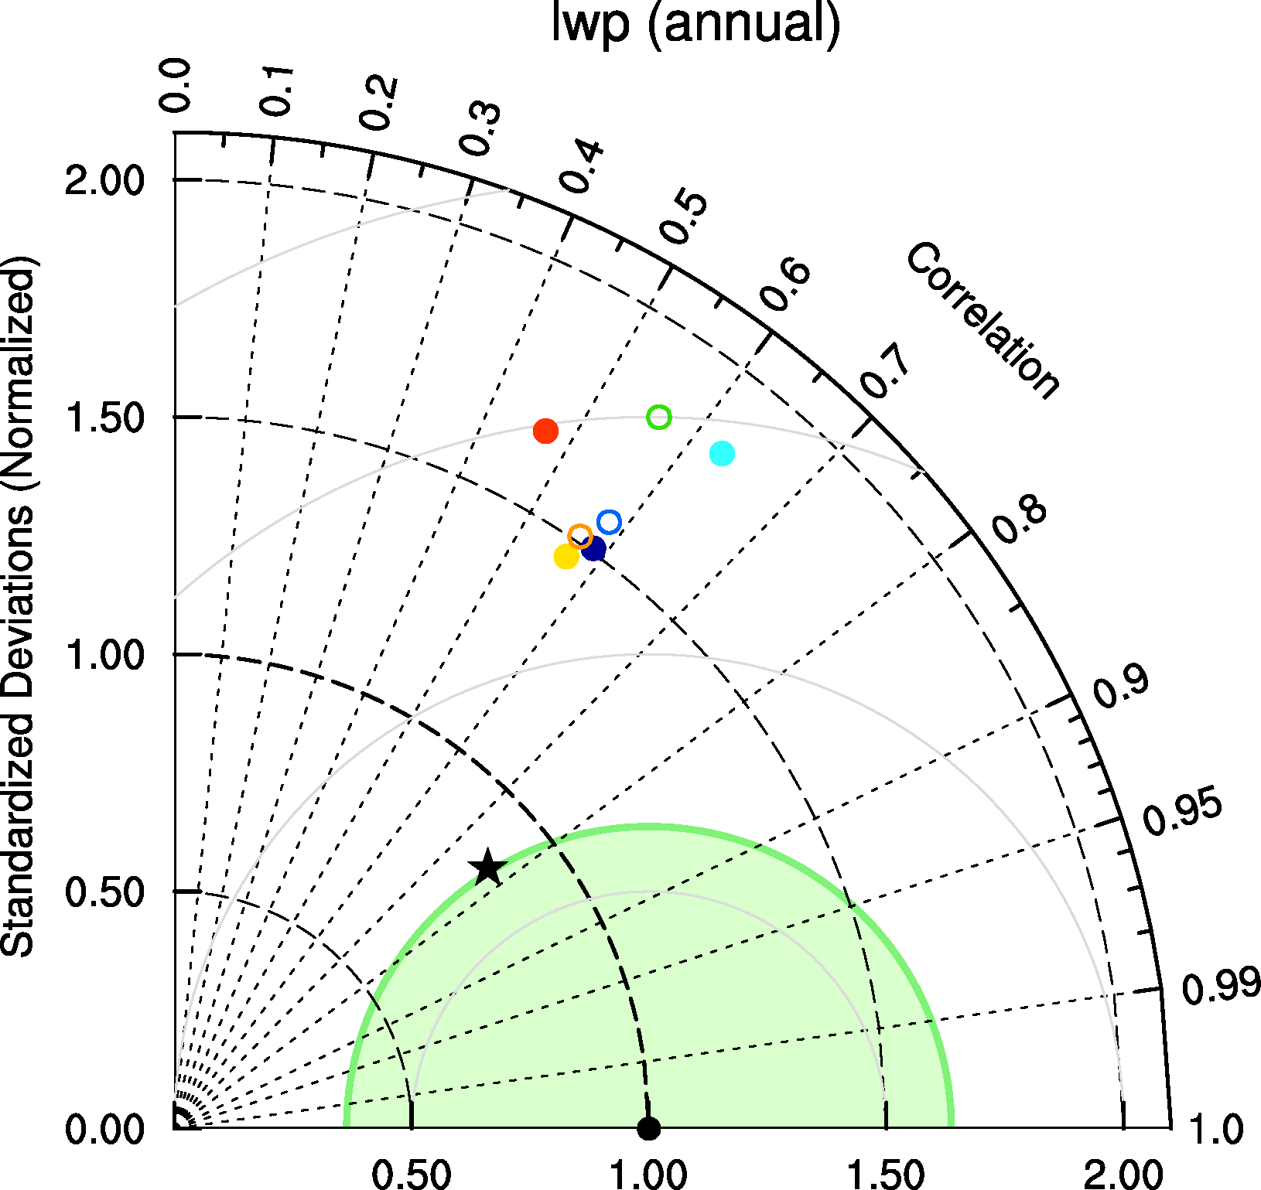
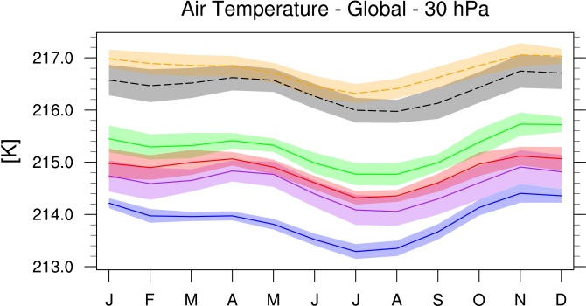
Diagnostics – Performance metrics

Slide 16
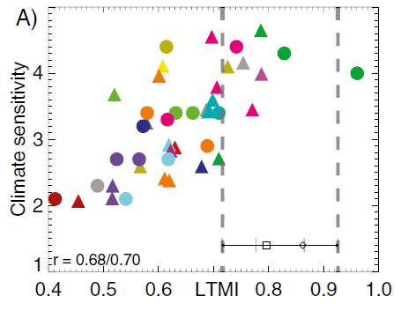
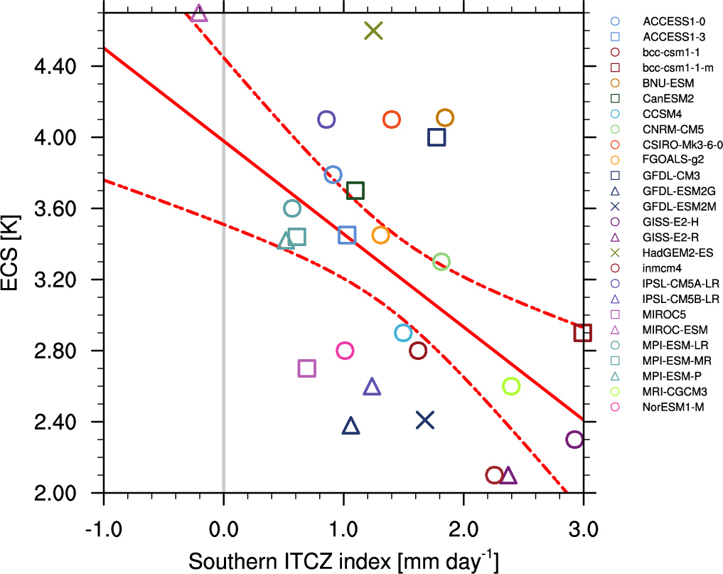
Emergent Constraints
Emergent Constrains are relationships across an ensemble of models, between some aspect of Earth system sensitivity and an observable trend or variation in the current climate.
Wenzel et al., Nature, 2016
60ºN-90ºN
~37%
Doubling CO2 concentration will lead to an increase in land photosynthesis of about a third.
Relative GPP increase at CO₂ doubling
Sherwood et al., 2014
Tian, 2015: Southern ITCZ index
radiosondes and reanalyses

Slide 17
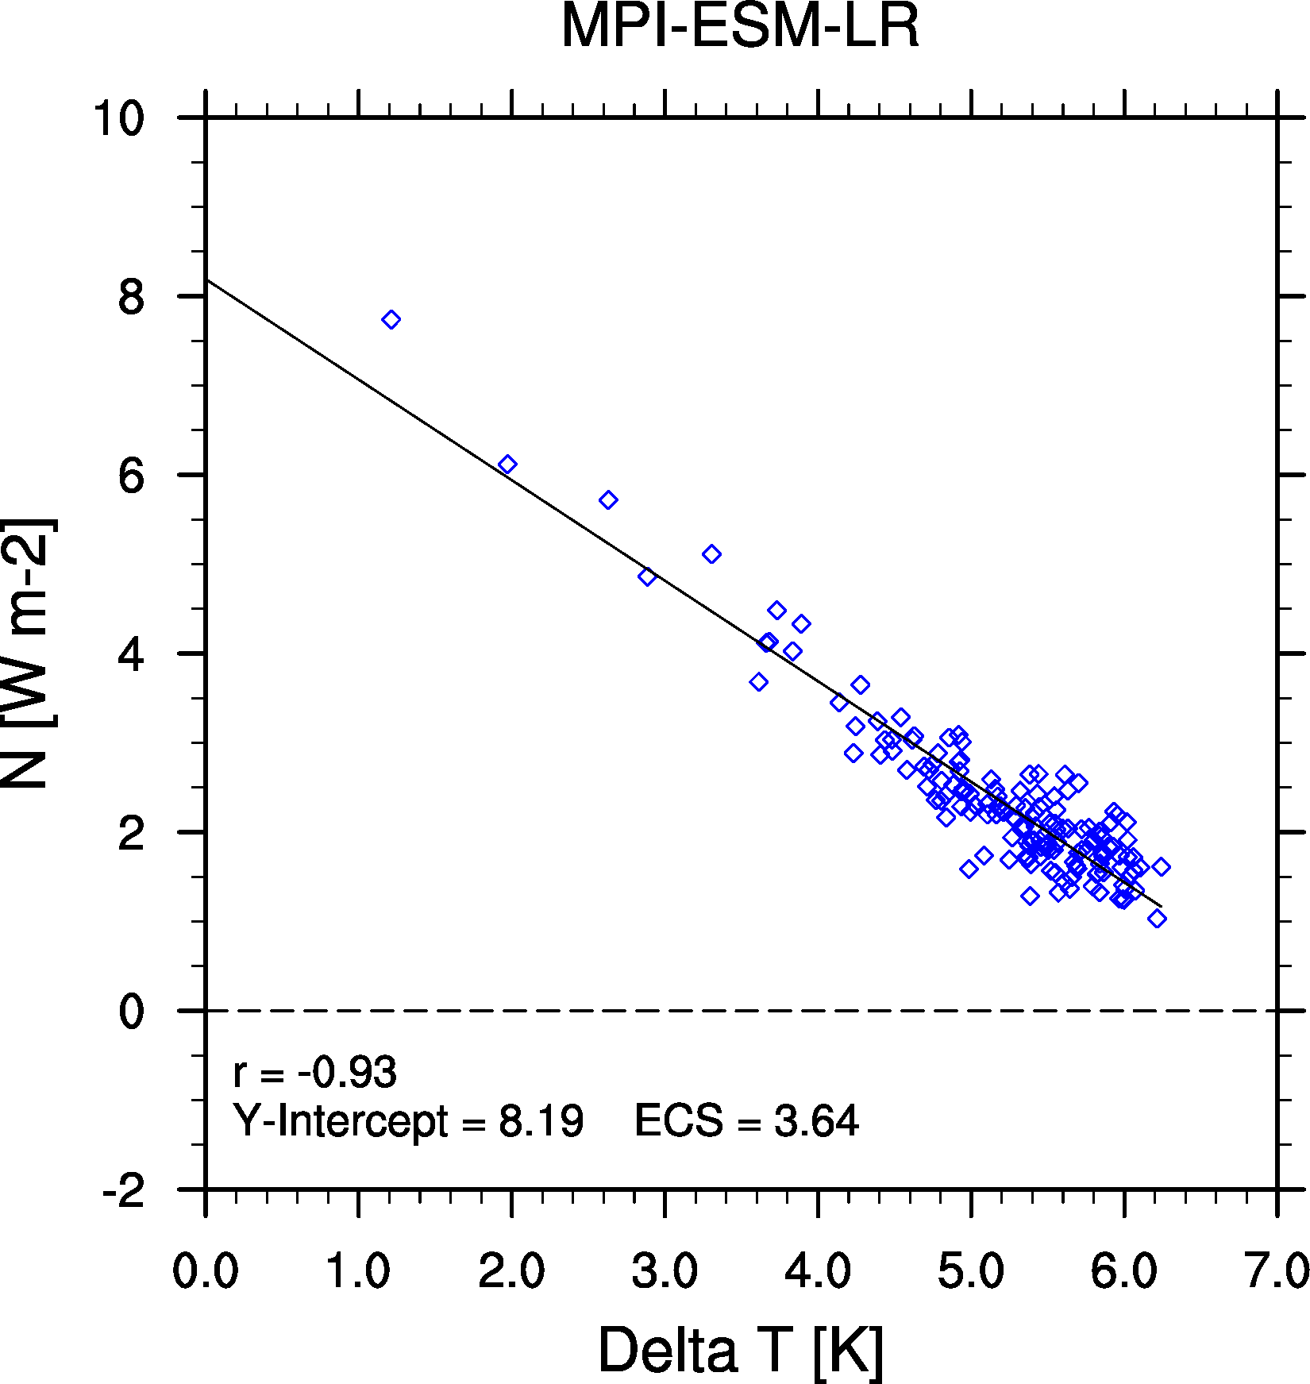

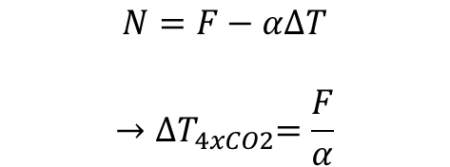
Equilibrium Climate Sensitivity (ECS)
Calculation
Quadrupling of CO₂ (abrupt4xCO2)
Perturbations of global annual mean surface temperature and TOA net radiative flux (abrupt4xCO2 - piControl)
150 model years of data
Linear fit of perturbations (ΔT, N)
F
$$N=F−α∆T$$
$$→{∆T}_{4xCO2}=\frac{F}{α}$$
y-intercept
-slope
$$ECS={∆T}_{2xCO2}=\frac{1}{2}{∆T}_{4xCO2}$$
CMIP5 results as in Andrews et al., 2012

Slide 18
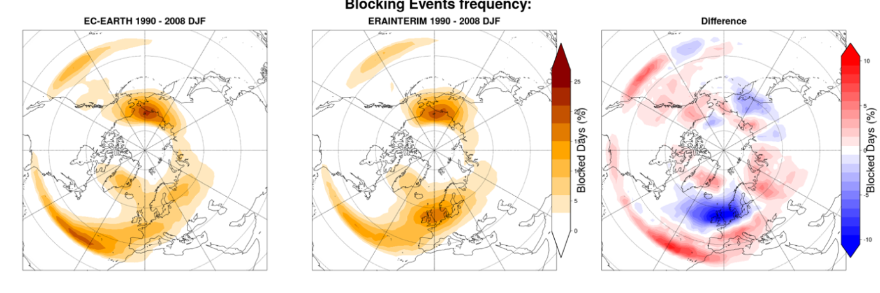
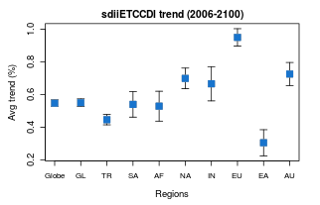
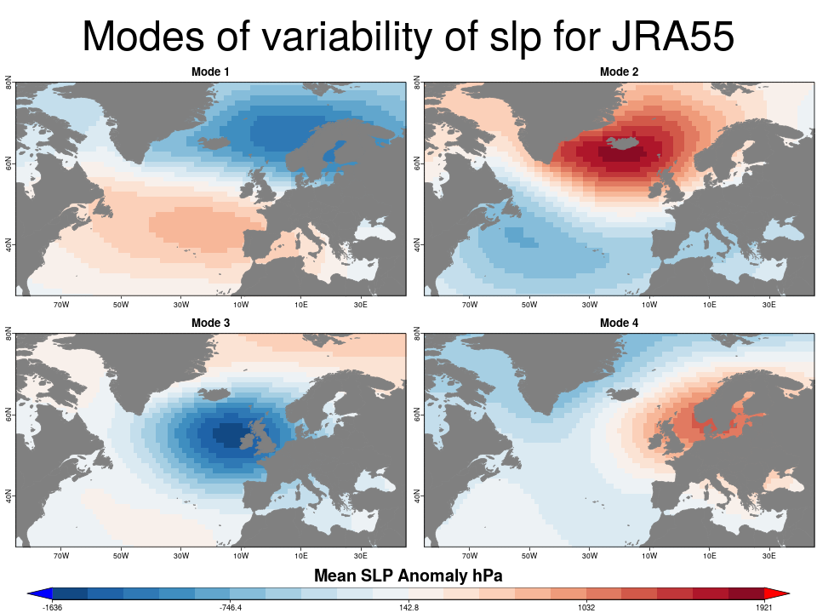


Performance metrics for extreme events & variability (C3S-MAGIC)
Figure example – 2D blocking events frequency
for EC-Earth over 1990-2008 (DJF)
Figure: summary of trend coefficients calculated for the ETCCDI sdii index over the continental and global reference regions for EC-Earth in 2006-2100. Significance is color coded (gray = 90%, blue = 95%).

Slide 19


Observational data
Data sets are grouped into 3 classes
Tier 1
Data sets from the obs4MIPs and ana4MIPs archives:
https://www.earthsystemcog.org/projects/obs4mips/ https://www.earthsystemcog.org/projects/ana4mips/
Tier 2
Other freely available data sets
Tier 3
Restricted data sets (e.g., license agreement required)

Slide 20
Available observational data v1.0
Aerosols + chemistry
ACCESS (mmrbc)
AERONET (od550aer)
AURA-MLS-OMI (tropoz)
AURA-TES (vmro3)
CARSNET (od550aer)
CASTNET (concso4, concno3, concnh4)
CIRRUS (mmrbc, mmrbcfree)
CONCERT (mmrbc, conccnSTP14)
CR-AVE (mmrbc)
DC3 (mmrbc)
EANET (concso4, concno3, concnh4)
EMEP (concso4, concno3)
EMMONS (various trace gases)
ESRL (co2)
GLOBALVIEW (vmrco)
GTO-ECV (toz)
HIPPO (mmrbc)
IMPROVE (concso4, concno3, concnh4, concbc, concoa, concpm2p5, concpm10)
INCA (conccnSTP5, conccnSTP14, conccnSTP120)
LACE (sizecn)
Melpitz (sizecn)
MODIS (od550aer)
NIWA (toz)
Putaud (sizecn)
SALTRACE (mmrbc)
TC4 (mmrbc)
Texas (mmraer, mmrbc)
Tilmes (vmro3)
UCN-Pacific (conccnSTP3)

Slide 21
Available observational data v1.0
Meteorology
AIRS (hur, ta)
CERES (rsuscs, rsus, rsdscs, rsds, rluscs, rlus, rldscs, rlds, rsutcs, rsut, rlutcs, rlut)
CloudSat (clt)
CMAP (pr)
CRU (tas, pr)
ERA-40
ERA-Interim (ta, ua, va, zg, hus, tas, tos, ps, psl, tauu, tauv, clwvi, clivi, sftlf, pr, evspsbl, hfls, hfss, rsns, rlns)
GPCC (pr)
HadCRUT (tas)
HALOE (vmrh2o)
MERRA (pr)
MODIS (clivi, clwvi, clt)
NCEP (ta, ua, va, zg, hus, tas)
NOAA-PSD (rlut)
OAFlux (hfls)
SRB (rsut, rlut, rlutcs)
TRMM (pr)
Uwisc (clwvi)

Slide 22
Available observational data v1.0
Land
GCP (co2flux)
LandFlux-EVAL (et, et-sd)
Ocean
Dong08-ARGO (mlotst)
ETH-SOM-FFN (spco2)
HadISST (ts)
SeaWIFS (chl)
SOCAT (spco2)
Takahashi14 (talk)
WOA09 (so, sos, to, tos)
Woa2005 (o2)
Sea ice
HadISST (sic)
NSIDC (sic)

Slide 23
Examples of new observational datasets
Aerosols/chemistry/meteorology/land/ocean/sea ice
ACCESS-2 (conccnd5, conccnd10)
Asmill (aerosol size)
CFSR (psl)
CloudSat (clt)
ESA CCI AEROSOL (od550aer, abs550, od550lt1aer, od870aer)
ESA CCI CLOUD (clt, clwvi, clivi)
ESA CCI GHG (xco2, xch4)
ESA CCI OZONE (tro3, tropoz, toz)
ESA CCI SEAICE (sic)
​ESA CCI SOILMOISTURE (sm)
ESA CCI SST (ts)
ESRL (surface CO₂)
HadCRUT4 (tas)
HIPPO (mmrbc)
HWSD (soil carbon content)
ISCCP (albisccp, clisccp, cltisccp, cttisccp)
JMA-TRANSCOM (CO₂ exchange)
LAI3g (leaf area index)
MTE (gross primary productivity of carbon)
NDP (vegetation carbon content)
NIWA (toz)
TOMS (toz)
WHOI-OAFlux (hfls, hfss)

Slide 24
4. ESMValTool Result Browser for CMIP at DKRZ

Slide 25
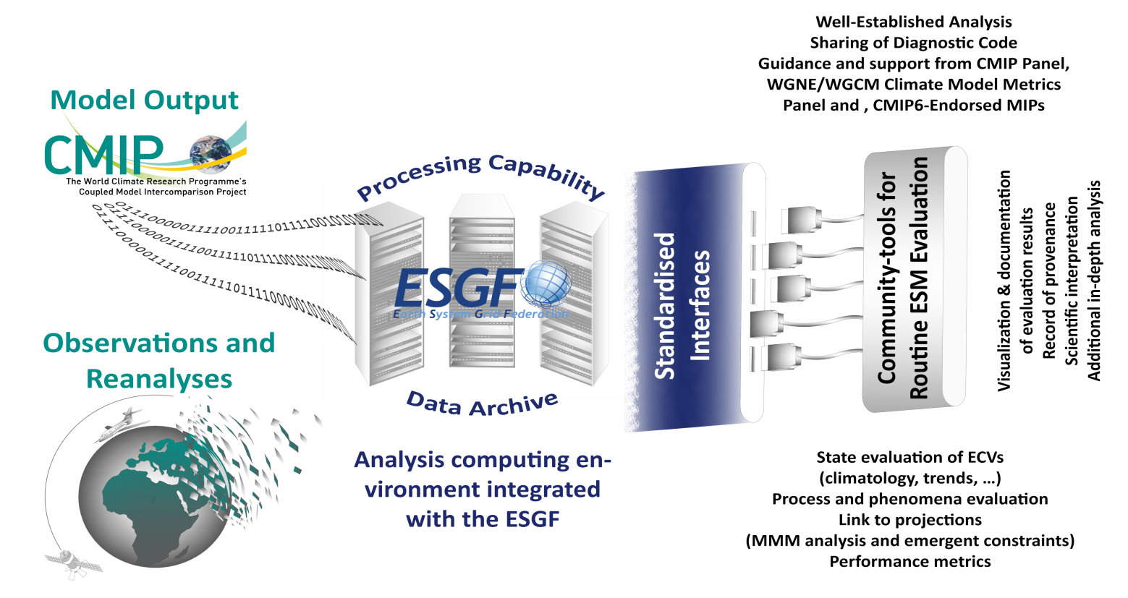
Envisaged Workflow for Routine Evaluation in CMIP
- Ensuring traceability and provenance of the results -
obs4MIPs
ana4MIPs
Eyring et al., ESD (2016)
Results at http://cmip-esmvaltool.dkrz.de/

Slide 26
Example for integration of the ESMValTool into the CMIP6 Workflow at the DKRZ*
Production phase
Data management phase
Routine evaluation
DKRZ
ESGF
Create compliance to CMIP conventions (CMORize, Metadata, etc.)
cmorized
routine
evaluation
Technical
quality control
ESGF remote
write simulation output timestep
publication
to ESGF
ESGF local
web visualization
Scientific quality control
AWI-CM
MPI-ESM
monitoring
EMAC
native
Results at http://cmip-esmvaltool.dkrz.de/
*Defined in the Project CMIP6-DICAD

Slide 27
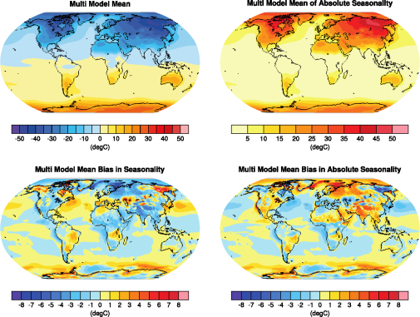
Improved provenance – traceability and reproducibility
Log-files
Creation date
Host and user
Version number of the ESMValTool
List of namelists / diagnostics run
Variables and models processed
List of all model files that have been used including + Tracking ID (read from metadata if available)
Patches applied to model data (if any)
List of all observations used including references
Contributing authors and acknowledgement of projects
Tagging: meta data attached to image files
namelist
diagnostic
ESMValTool + Python version
input files (tracking id)
models + observations
figure caption
CMIP6 realm
variables
projects
theme
domain
contributing authors
plot type
statistics + metrics
references

Slide 28
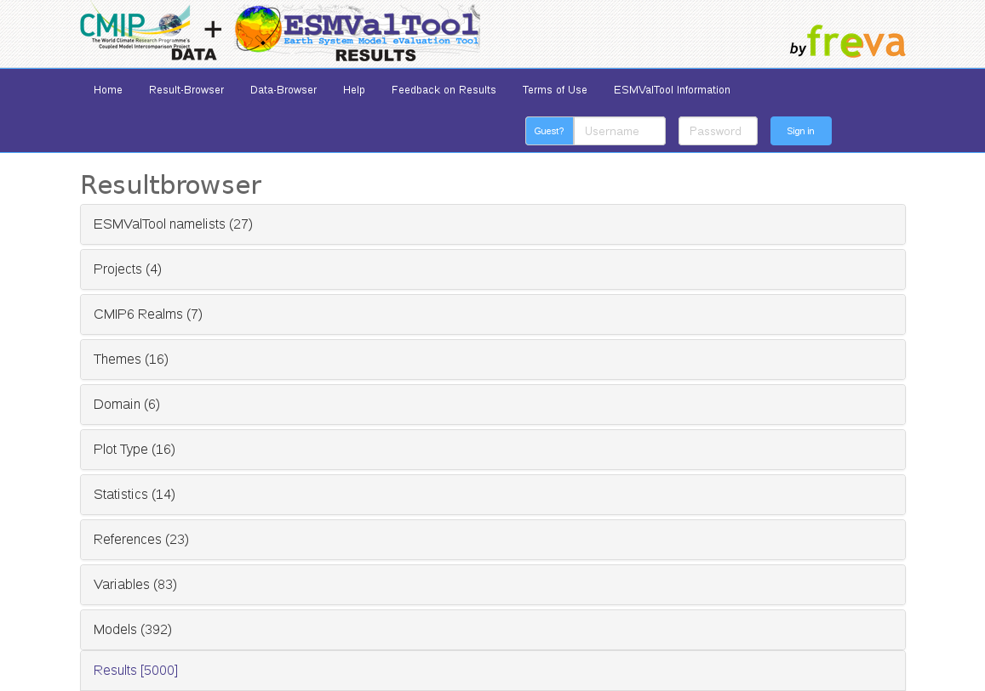
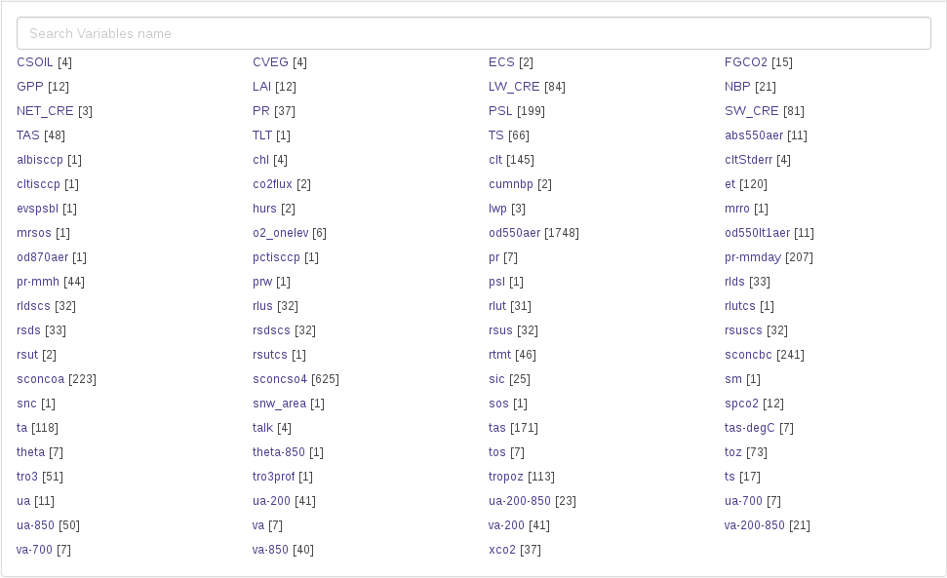
Visualization: ESMValTool Result Browser at DKRZ
Cooperation with FUB in BMBF CMIP6-DICAD project for routine evaluation of CMIP6 models as soon as output is submitted to the ESGF
http://cmip-esmvaltool.dkrz.de/
Filter by
namelist
theme
variable
model
reference
etc.

Slide 29
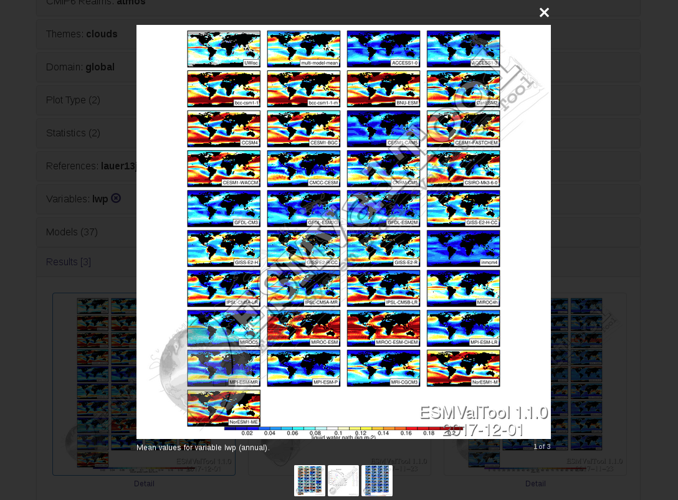
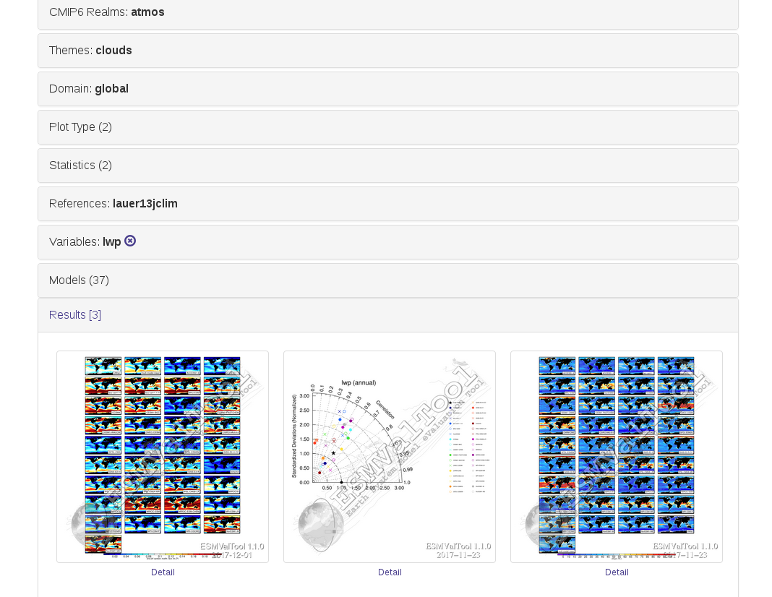
Visualization: ESMValTool Result Browser at DKRZ
Cooperation with FUB in BMBF CMIP6-DICAD project for routine evaluation of CMIP6 models as soon as output is submitted to the ESGF
variable lwp
(liquid water path)
http://cmip-esmvaltool.dkrz.de/
preview of available results
figure caption
details

Slide 30
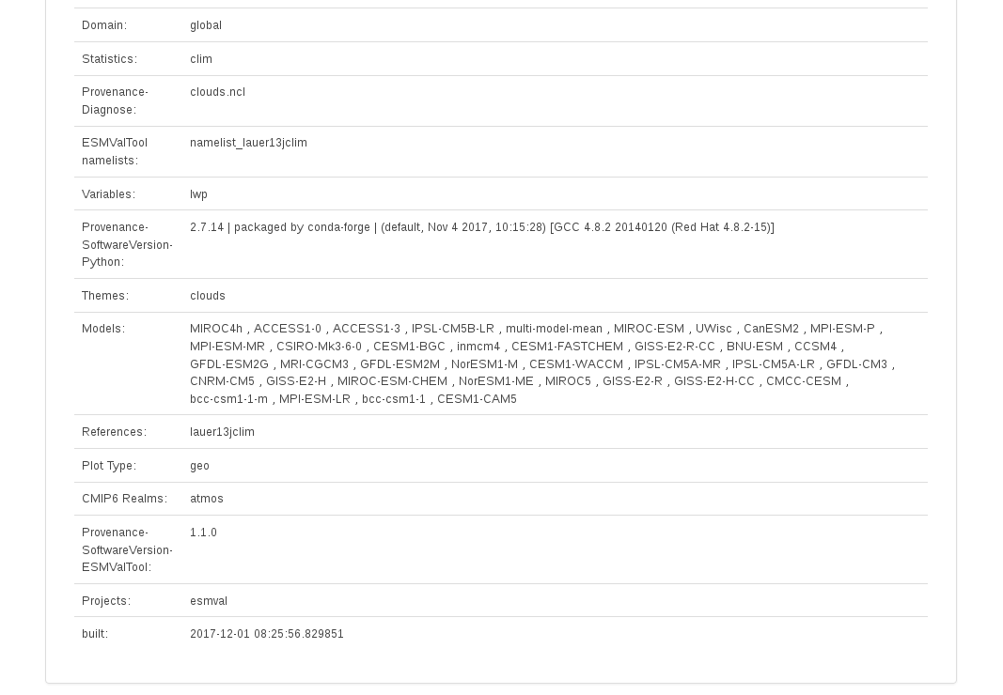
Visualization: ESMValTool Result Browser at DKRZ
Cooperation with FUB in BMBF CMIP6-DICAD project for routine evaluation of CMIP6 models as soon as output is submitted to the ESGF
Overview ESMValTool configuration and metadata from image files
http://cmip-esmvaltool.dkrz.de/

Slide 31
5. ESMValTool Quicklook and Monitoring Capability

Slide 32

Monitoring with ESMValTool
Advantages
Direct comparison with observations and previous simulations
Several additional diagnostics of the ESMValTool can be used in the monitoring (e.g. NCAR CVDP)
Dashboard: fast detection of errors in the simulations
Monitoring of emissions
Development in Private GitHub repository
Branch private/CMIP6DICAD_quicklooks_new
(https://github.com/ESMValGroup/ESMValTool-private/tree/CMIP6DICAD_quicklooks_new)
Readme https://github.com/ESMValGroup/ESMValTool-private/tree/CMIP6DICAD_quicklooks_new/util/qlwrapper

Slide 33
Monitoring with ESMValTool
Technical Solution
One dedicated namelist template for the quicklooks
General and dedicated diagnostics
Wrapper that executes the ESMValTool diagnostics in parallel on HPC machine (currently DKRZ only)
Website that presents results website, update via cron-job
Activation upon request (setup of password restricted website, configuration of quicklook-system, etc. )
Trigger with call from jobscript

Slide 34
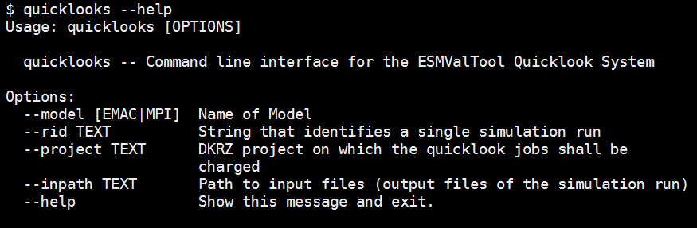
Call from job script @ DKRZ:

Slide 35

ESMValTool Quicklook System @ DKRZ Monitoring of CMIP6 Model Simulations running at DKRZ
Mistral
Modvis webserver
Climate model
job script
Rescheduling
cycle (8h)
Quicklook
system
Web application
data storage
cron/rsync

Slide 36
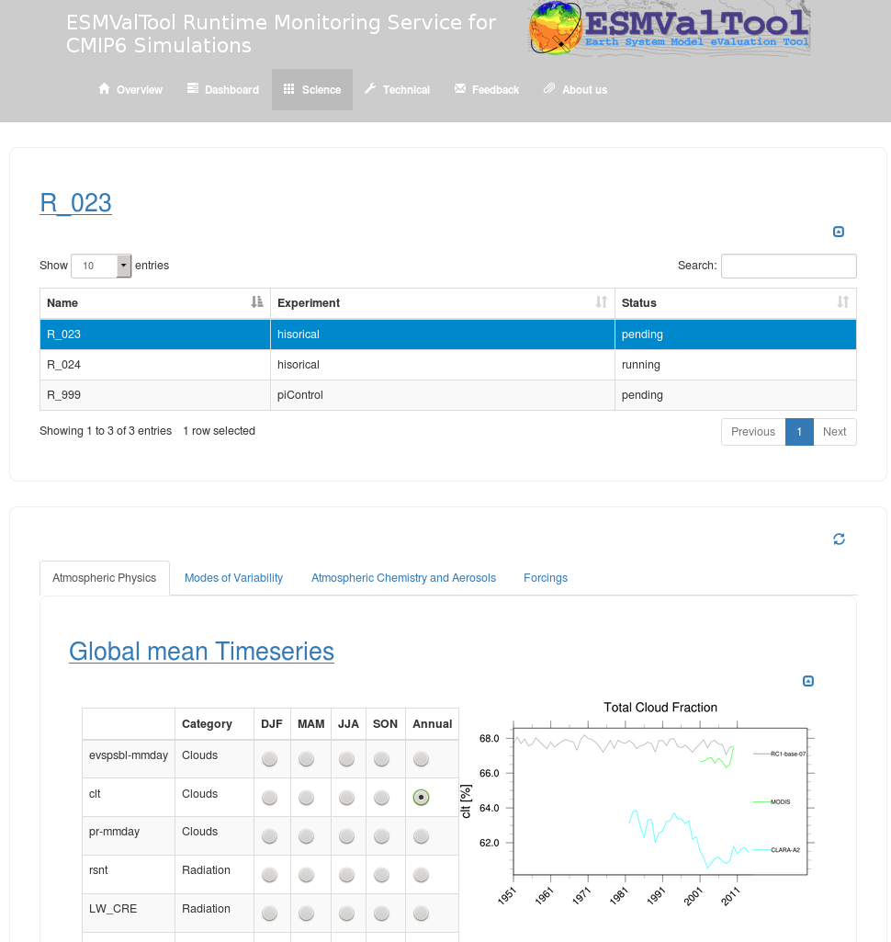
Online demonstrator
Select run
Select topic
Select variable/Season

Slide 37

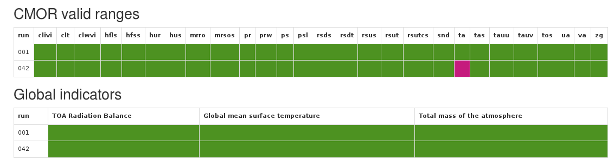
Monitoring: Dashboard
Warning system
Check if gridbox values of variables lie in the range of valid min and valid max value given by CMIP6 data request (with contribution of Martin Juckes, CEDA)
(ta, tas, tos, pr, prw, ps, psl, …)
Other important checks:
radiation balance
global tracer mass
… (furher input of modeller groups is needed)
 | Experiment | ta | tas | tos | ps | … | F_{net} | … | ...
Run1 | piControl
Run2 | historical
…

Slide 38
Monitoring: Dashboard
CMOR Variable | Title | Min | Max
clivi | Ice Water Path | -1.872e-06 s | 1.535 s
clt | Cloud Amount | -0.001 r | 100.001 r
clwvi | Condensed Water Path | -3.827e-06 s | 3.364 s
hfls | Surface Upward Latent Heat Flux | -90.0 r | 850.0 r
hfss | Surface Upward Sensible Heat Flux | -400.0 s | 1200.0 s
hur | Relative Humidity | -2.642 s | 135.7 s
hus | Specific Humidity | -0.000299 s | 0.02841 s
mrro | total runoff | -0.0002019 s | 0.001065 s
mrsos | Moisture in Upper Portion of Soil Column | -2.008 s | 146.5 s
pr | Precipitation | -1e-06 r | 0.0015 r
prw | Column water vapor | 0.0 r | 90.0 r
ps | Surface Air Pressure | 47500.0 r | 112000.0 r
psl | Sea Level Pressure | 91000.0 r | 109000.0 r
rsds | Surface Downwelling Shortwave Radiation | -0.1 r | 550.0 r
rsdt | TOA Incident Shortwave Radiation | 0.0 s | 580.4 s
rsus | Surface Upwelling Shortwave Radiation | -0.1 r | 480.0 r
rsut | TOA Outgoing Shortwave Radiation | -0.1 r | 480.0 r
rsutcs | TOA Outgoing Clear-sky Shortwave Radiation | -0.1 r | 480.0 r
snd | Snow Depth | 0.0 s | 962.9 s
ta | Temperature | 157.1 s | 336.3 s
tas | Near-Surface Air Temperature | 170.0 r | 350.0 r
tauu | Surface Downward Eastward Wind Stress | -10.0 r | 10.0 r
tauv | Surface Downward Westward Wind Stress | -10.0 r | 10.0 r
tos | Sea Surface Temperature | 257.4 s | 325.2 s
ua | Eastward Wind | -68.65 s | 136.6 s
va | Westward Wind | -71.1 s | 69.93 s
zg | Geopotential Height | -719.7 s | 34370.0 s

Slide 39
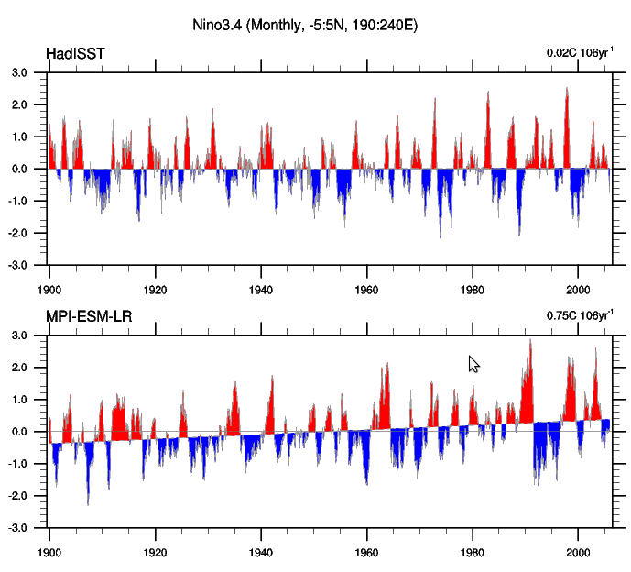
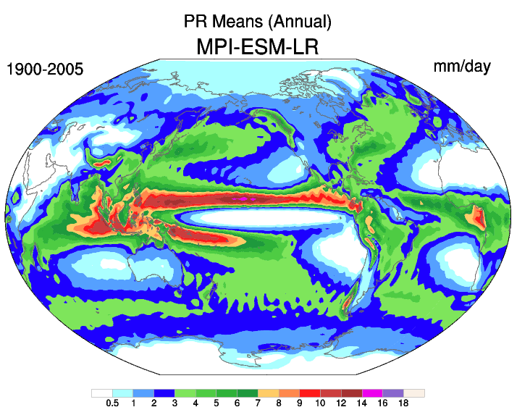
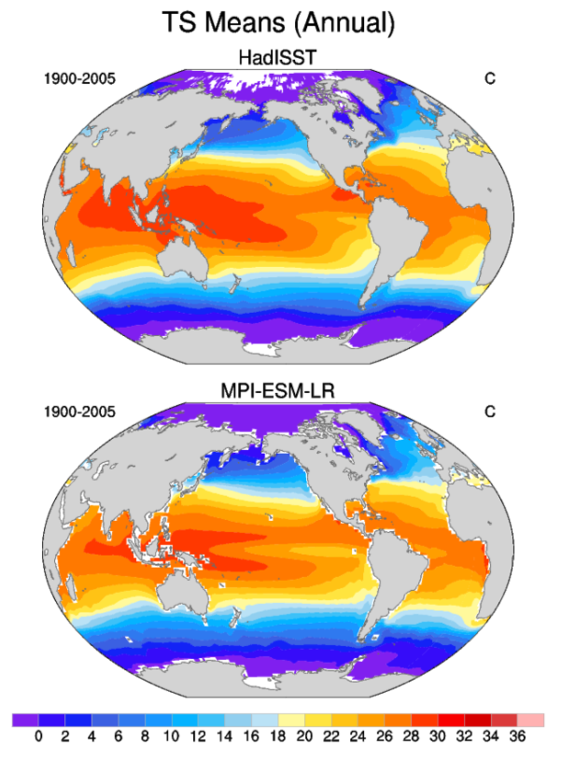
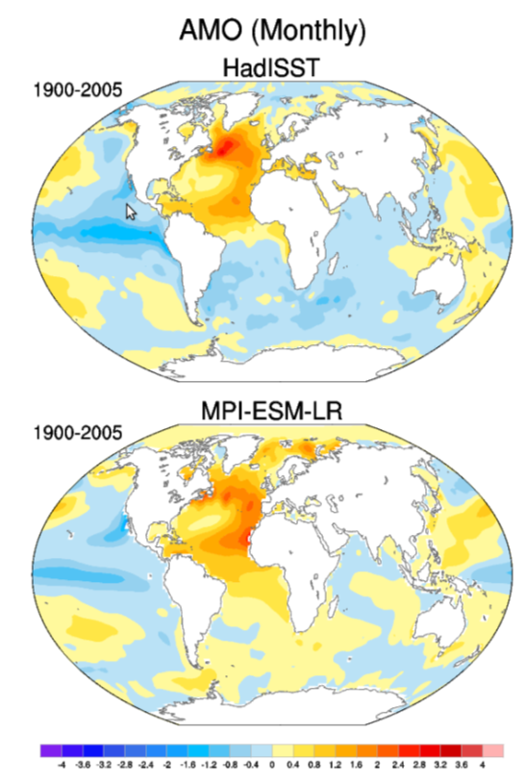
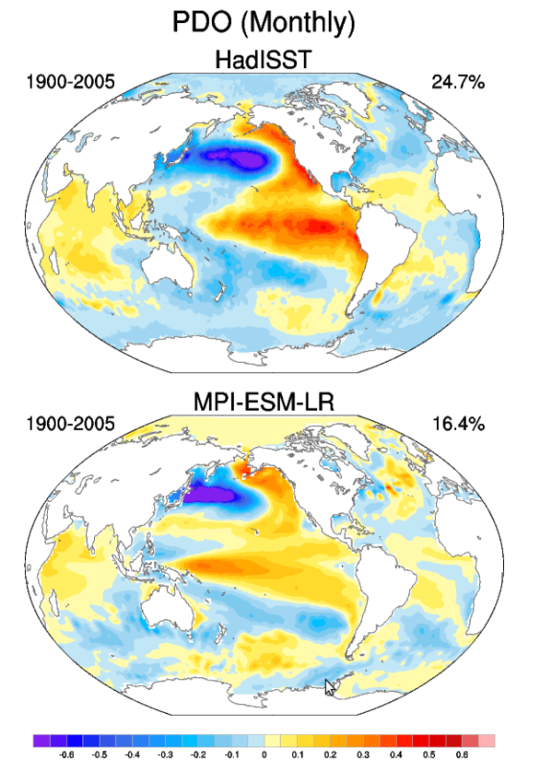
NCAR Climate Variability Diagnostic Package (CVDP)
Phillips et al., EOS, 2014
Nino3.4
precipitation
Niño3.4, NAM, SAM, NAO, PDO, PNA, NPO, PSA1, PSA2, AMOC, SST, TAS, PR, SIC SH, SIC NH, Niño1+2 Timeseries, Niño3 Timeseries, Niño4 Timeseries
sea surface temperature
AMO
PDO

Slide 40

Example diagnostic for the monitoring of idealized simulations: calculation of equilibrium climate sensitivity from piControl and 4xCO₂ simulations
red cross: independent estimation of the 4xCO2 adjusted radiative forcing from fixed-SST experiments
Relationships between the change in net top-of-atmosphere radiative flux, N, and global-mean surface-air-temperature
change, DT, after an instantaneous quadrupling of CO2.
N=0: equilibrium DT, which can alternatively be estimated by F/a
DT=0: adjusted radiative forcing, F
slope of the curve: strength of the feedbacks in the climate system, the ‘climate feedback parameter’
Andrews et al., GRL (2012)

Slide 41
Monitoring of Emissions
Anthropogenic Reactive Gas Emissions: SO2, NOx, NH3, CH4, CO, NMVOC, BC, OC
Fossil Carbon Dioxide
Open burning emissions: aerosol (BC,OC) and aerosol precursor and reactive compounds (SO2, N2O, NOx, NH3, CH4, CO, NMVOC) and CO2
Land use
GHG Concentrations
Stratospheric Aerosols
Ozone
Nitrogen Deposition
Solar
AMIP Boundary Forcing: Sea Surface Temperature and Sea Ice Datasets

Slide 42
6. Technical Improvements

Slide 43


Technical Work ESMValTool
Maintenance, Technical Infrastructure, Interfaces, and Documentation
Changed to versioning system git
Documentation and user’s guide converted (Sphinx)
Tagging and improved provenance
New backend using Iris, full merge with Auto-Assess (work in progress)
Automated testing and reporting package
Quicklook capability added
Visualization
Coupling to the ESGF at DKRZ
Several coding workshops were held to enhance the ESMValTool

Slide 44
Enhancement of the ESMValTool Backend
MOTIVATION
The ESMValTool applies several common pre-processing operations (e.g., time extraction, format checks, regridding, masking, etc.) to the input data.
In the current version, most of these operations are currently performed at the diagnostic level
DRAWBACKS
Slow performance, code duplication, lack of consistencies, low user-friendliness
GOAL
Collect and recode most common preprocessing operations at a higher level, in a single, fast and efficient preprocessing backend
Joined development effort among several partners
DLR (Germany), NLESC (Netherlands), BSC (Spain), MetOffice (UK), URead (UK)

Slide 45
Development status revised ESMValTool Backend
Implemented and tested
Revised backend infrastructure, now fully based on python and the IRIS library (MetOffice)
Time extraction, CMORization, vertical & horizontal regridding, masking
New highly-flexible namelist format based on YAML to replace previous XML format
Revised workflow, including input data handling and parallelization capabilities
Ongoing work
Functionalities for multi-model statistics (mean and median) and variable derivation
Improved interface for the communication between workflow/backend and diagnostic scripts (including multi-language support)
Centralized and simplified configuration options (ESMValTool main namelists as single configuration point)
First tests show a factor 10-20 improvement in processing time!
Towards ESMValTool v2.0 release for CMIP6 with
… More efficient backend
… Provenance
… Additional diagnostics & namelists
Documentation paper v2.0 in preparation

